Slide 1
A Comparative Spatial Analysis of Urban Air Quality: New York City, Boston, and Chicago
Done by:
Wafa Alyammahi
Mera Alshamsi
Asma Al Ali
Nawaf Alnaqbi

Slide 2
Table of contents
01
02
07
08
03
Project Motivation & Goals
Research Questions
Related Work
04
05
06
Methodology Overview
Predictive Modeling
Validation Techniques
09
Results and Discussion
Policy Recommendations
Conclusion and Future Work

Slide 3
Introduction
Type intro here.

Slide 4
01
Project Motivation & Goals

Slide 5
Project Motivation & Goals
Urban air pollution significantly impacts public health and environment.
Focus on comparative air quality study in NYC, Boston, Chicago.
Analyze PM2.5, PM10, NO2 pollutants.
Integrate GIS, spatial indexing, machine learning.
Support evidence-based policy design.
Notes:
Speaker Notes (Nawaf): Urban air pollution poses severe health risks and environmental issues globally. Particulate matter such as PM2.5 and PM10 can deeply penetrate lungs, causing chronic illnesses and higher mortality rates. Recognizing that cities differ significantly in layout, industrial activities, and weather patterns, we set out to conduct a comparative analysis of urban air quality specifically for three major U.S. metropolitan cities—New York City, Boston, and Chicago. Our research leverages advanced geospatial tools, particularly GIS combined with H3 spatial indexing, along with clustering algorithms and multivariate regression models. The overarching goal is to provide policymakers with precise, data-driven insights for improving urban air quality.

Slide 6
02
Research Questions

Slide 7
Key Questions Driving Our Study
How does air pollution differ across New York City, Boston, and Chicago?
Which urban zones experience the highest levels of PM2.5 pollution?
What weather conditions most significantly influence air quality?
Can spatial techniques like H3 indexing improve the comparability of pollution data across cities?
Notes:
Speaker Notes: Our research addresses four central questions critical to understanding urban air pollution dynamics: First, we investigate how air pollution concentration patterns vary spatially across New York City, Boston, and Chicago. Secondly, we identify which city experiences the greatest PM2.5 pollution burden. Thirdly, we explore weather-related factors that significantly influence urban air quality, particularly temperature and humidity. Finally, we examine whether the integration of GIS-based spatial indexing and machine learning algorithms can facilitate more accurate and standardized comparisons of air quality between diverse urban environments.

Slide 8
03
Related Work

Slide 9
Related Work
Studies combining mobility data and air pollution.
Real-time analytics and geospatial techniques.
K-means clustering, land-use regression modeling.
Urban form effects on pollution.
Notes:
Speaker Notes: Existing research has extensively explored the integration of urban mobility patterns with air pollution analysis. Notably, Al Jawarneh et al. developed methods for handling heterogeneous mobility data and real-time analytics, foundational for our comparative approach. Additional relevant research includes Bandeira’s study on land-use impacts, Austin’s application of clustering techniques to air quality data, and Ross’s spatial-temporal estimation modeling in New York. These studies collectively underscore the necessity of advanced spatial and analytical methods—informing our methodological approach to comparing urban air quality.

Slide 10
04
Methodology Overview

Slide 11
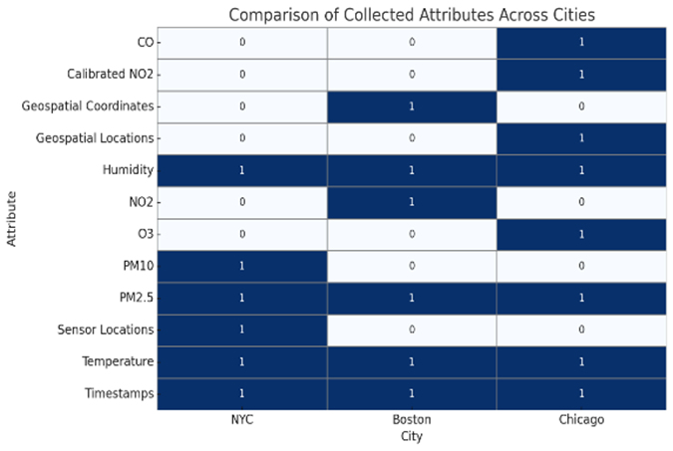
Data Collection
We gathered air quality and weather data from NYC, Boston, and Chicago using public sensors. The datasets included pollutants like PM2.5, PM10, and NO2, along with temperature, humidity, and location info. This gave us a solid foundation to analyze pollution patterns across different cities.
City | Direct Pollution Variables | Indirect Pollution Variables
NYC | pm25_pm, pm10, pm25_aq | temperature_pm, humidity_pm, location, SensorID
Boston | pm25, no2 | temperature, humidity, location, bins
Chicago | pm25, NO2, O3, CO | temperature, humidity, battery, signal

Slide 12
Data Cleaning
Ensuring all pollution and weather variables were clean, complete, and reliable for modeling.
Removing outliers that fell outside realistic environmental ranges (e.g., PM2.5 > 500).
Imputing missing values using forward-fill and mean methods to avoid data loss.
Filtering invalid sensor records (e.g., battery errors, empty readings).

Slide 13
Spatial Standardization (H3)
Problem — Sensors Are Everywhere. We collected pollution data from different cities. But sensors
We used a tool called H3 to divide each city into equal-sized hexagons. Each hexagon covers around 0.1 km². We selected H3 resolution 9, which generates hexagonal cells of approximately 0.1 km². This size was ideal for urban-scale analysis
Every reading (with latitude & longitude) is converted into a hexagon ID using H3.Now we know which hexagon each pollution value belongs to.
H3 Indexing Example :
Input: lat = 40.71, lon = -74.00
Output: h3 = '892a100accfffff'

Slide 14
Feature Engineering
Step | Why We Did It | How We Did It
Grouped data by H3 hexagon | To organize data into equal spatial zones for fair comparison. | Used groupby('h3') in pandas for each city’s dataset.
Calculated averages (PM2.5, etc.) | To summarize air quality per area and remove random sensor spikes. | Used .mean() on grouped data (e.g. PM2.5, PM10, Temp, Humidity).
Computed standard deviations | To understand local variation and detect unstable pollution zones. | Applied .std() on grouped variables.
Counted number of readings per hex | To measure data reliability — more readings = more trust. | Added a .count() column to know how many records exist per H3 cell.
Dropped hexes with low data | To avoid noise from areas with too little data. | Filtered out rows where count < threshold (e.g., less than 10 readings).
Applied Z-score normalization | To scale all variables fairly before applying ML models. | Used StandardScaler() from scikit-learn on selected numerical features.

Slide 15
Ready for Modeling
This table is the final structured dataset used for modeling. Each row represents a hexagonal area with averaged pollution and weather features, ready for clustering and regression. The city column ensures clear separation across NYC, Boston, and Chicago.
city | h3_index | pm25_mean | pm10_mean | temp_mean | humidity_mean | count
NYC | 892a100accfffff | 13.4 | 20.1 | 22.5 | 60.8 | 30
NYC | 892a100acd3ffff | 11.9 | 18.3 | 23.1 | 59.4 | 27
Boston | 892a100aca3ffff | 10.8 | – | 18.7 | 67.2 | 34
Boston | 892a100aca7ffff | 12.2 | – | 19.1 | 70.4 | 40
Chicago | 892a100acb3ffff | 9.6 | – | 20.5 | 61.9 | 29
Chicago | 892a100acb7ffff | 14.3 | – | 21.3 | 59.1 | 32

Slide 16
Ready for Modeling : Data is
Balanced: features are normalized and consistent in scale
Clean: no missing or noisy values
Structured: every cell is meaningful and organized
Aggregated: summarizes raw sensor data into useful insights

Slide 17
05
Predictive Modeling

Slide 18
1- K-Means Clustering:
Purpose:
Number of clusters:
To identify pollution zones.
k=3 selected using the Elbow Method.
Features used:
Interpretation
PM2.5
PM10/NO2
Temperature
Humidity (z-score normalized)
Each cluster represents a pollution level (low, medium, high).

Slide 19
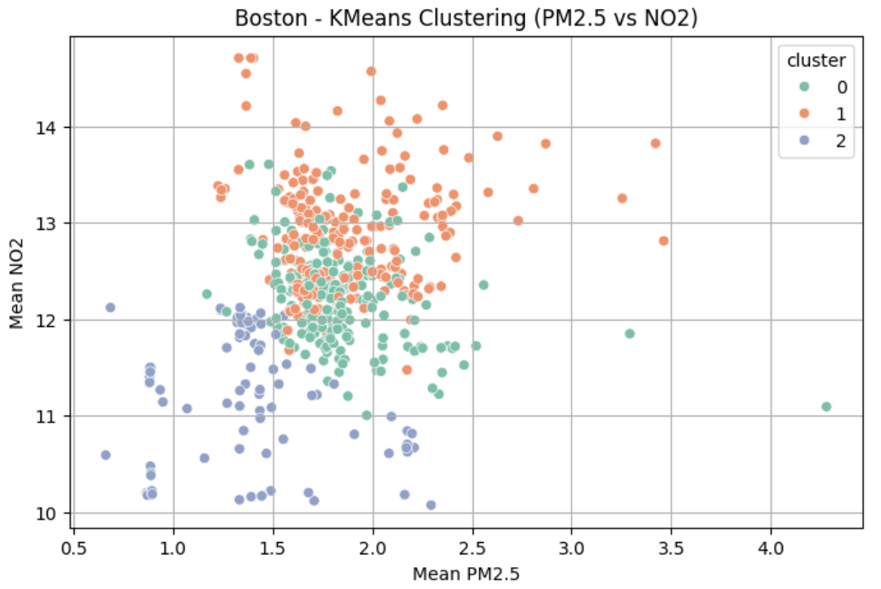
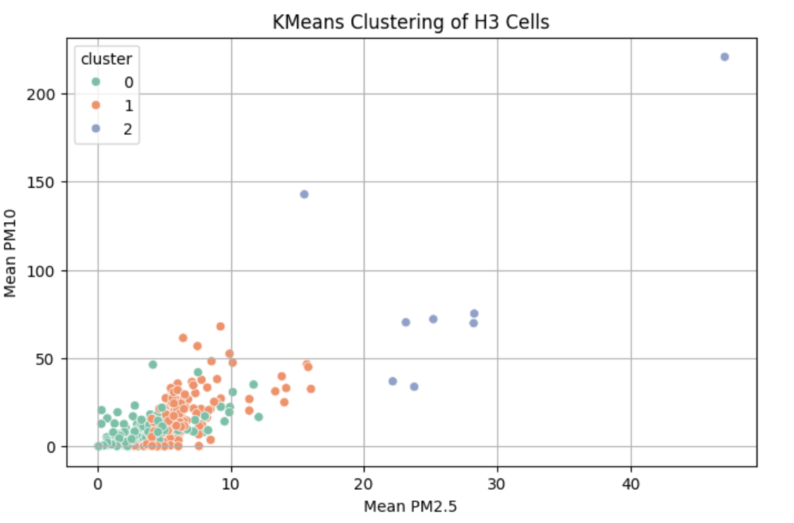
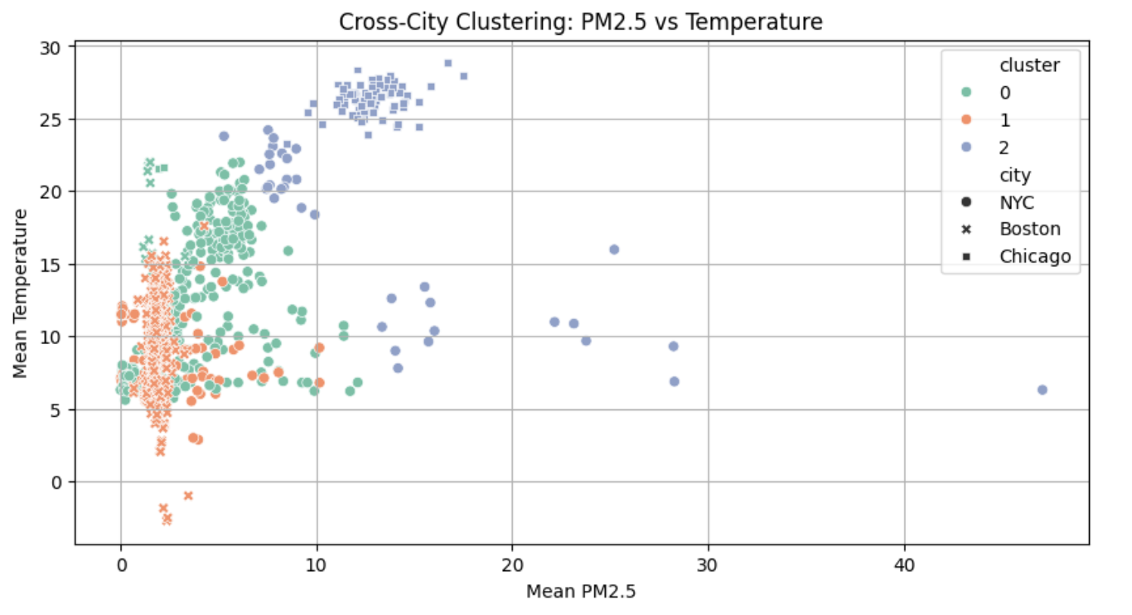
1- K-Means Clustering:
Cluster 2 (high): PM2.5=26.69, PM10=90.18, Humidity=77.5%
This cluster is strongly associated with traffic-heavy and industrial zones.
Helps identify pollution hotspots

Slide 20
2- Regression Analysis Using Statsmodels (OLS):
PM2.5 =β0 +β1 ⋅Temperature+β2 ⋅Humidity+ε
Goal: Quantify how temperature and humidity affect PM2.5.
If β₁ is positive, warmer temperatures tend to increase PM₂.₅.
If β₂ is negative, higher humidity tends to reduce PM₂.₅.
Software used:
Statsmodels Python library
Ordinary Least Squares (OLS) regression

Slide 21
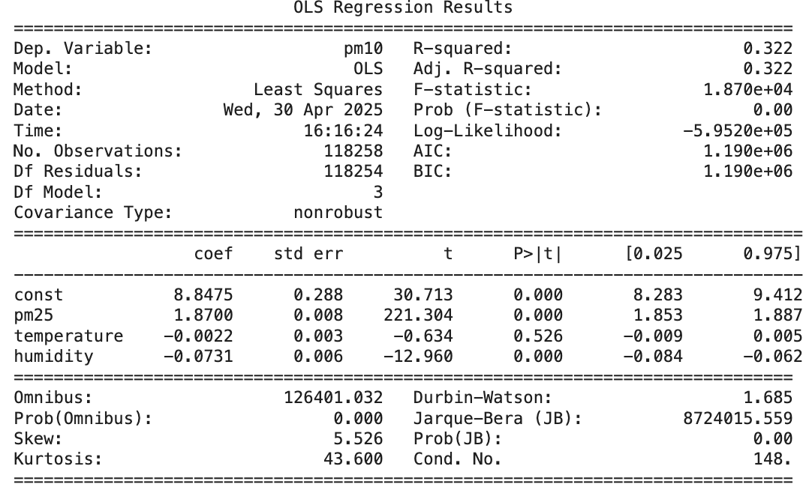
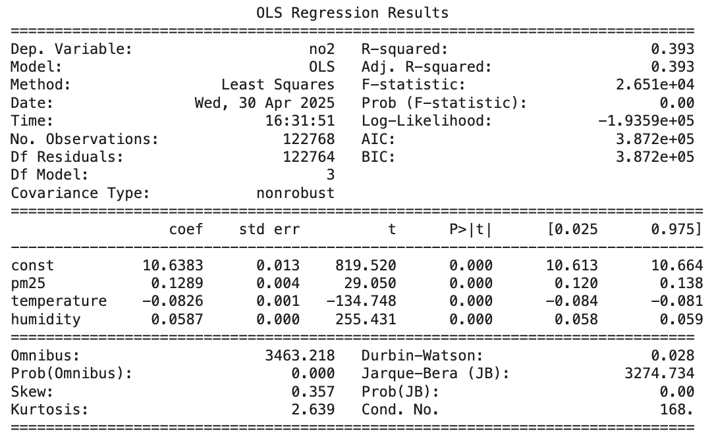
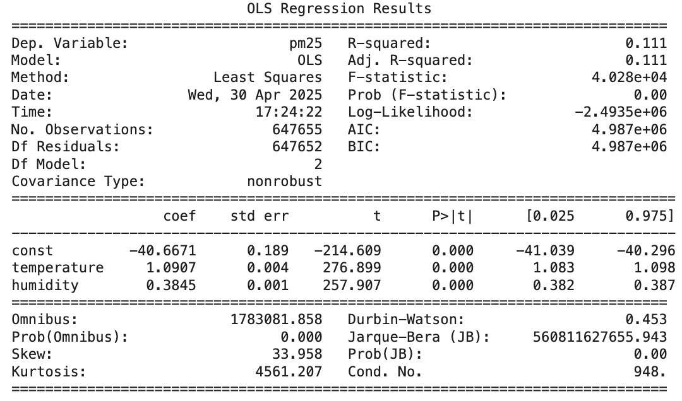
2- Regression Analysis Using Statsmodels (OLS):
NYC
Boston
Chicago

Slide 22
06
Validation Techniques

Slide 23
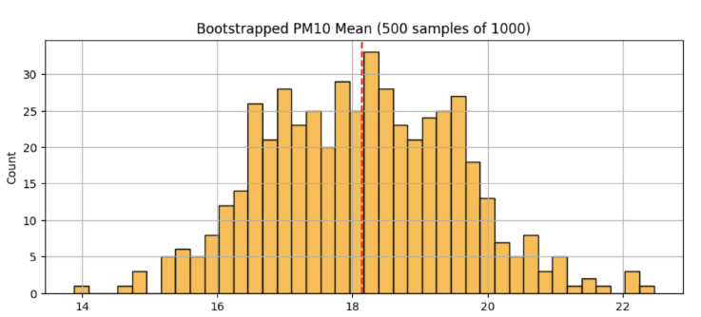
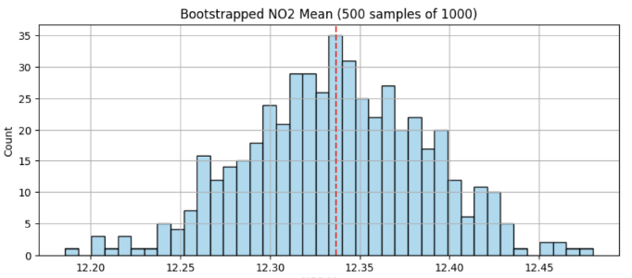
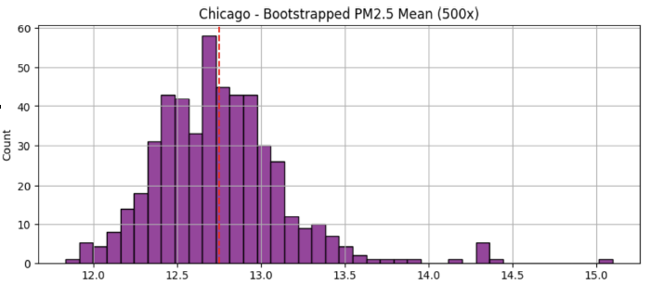
1- Bootstrapping:
Purpose: Assess stability of regression coefficients.
Method: Re-sample data (e.g., 1,000 times) → re-fit regression → observe variation in coefficients.
Output: Confidence intervals for regression coefficients (β) values
Notes:
Speaker Notes: To ensure the robustness and reliability of our predictive modeling, we employed rigorous validation techniques, specifically bootstrapping and Root Mean Square Error (RMSE). Bootstrapping involved repeatedly resampling our dataset to evaluate the stability of our regression coefficients, providing confidence in our findings. Meanwhile, RMSE assessed predictive accuracy, quantifying the difference between observed and predicted values to verify model precision and reliability across diverse urban environments.

Slide 24
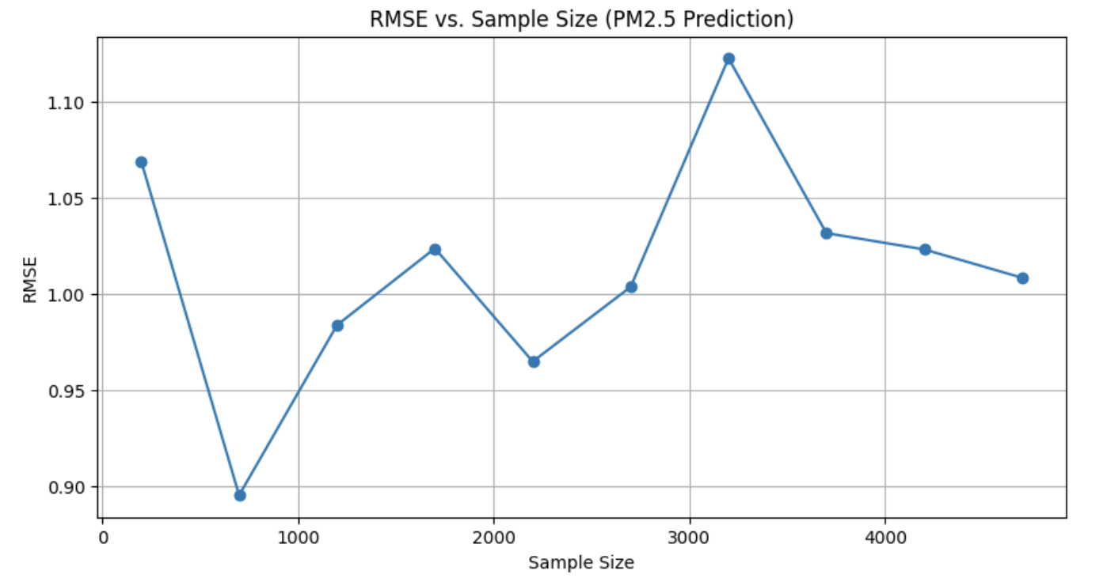
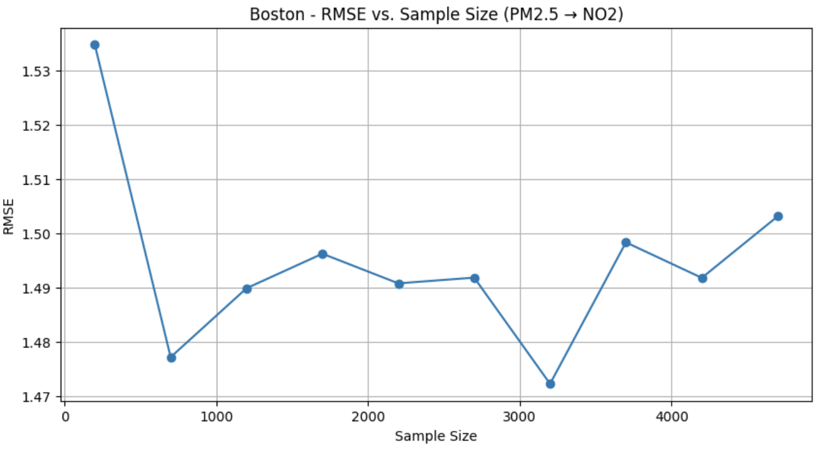
2- Root Mean Square Error (RMSE):
Definition: RMSE (Root Mean Square Error) measures prediction error.
Purpose: Evaluate how well the regression fits unseen data.
Trend: RMSE decreases with more samples, stabilizes after a point.
Notes:
Speaker Notes: To ensure the robustness and reliability of our predictive modeling, we employed rigorous validation techniques, specifically bootstrapping and Root Mean Square Error (RMSE). Bootstrapping involved repeatedly resampling our dataset to evaluate the stability of our regression coefficients, providing confidence in our findings. Meanwhile, RMSE assessed predictive accuracy, quantifying the difference between observed and predicted values to verify model precision and reliability across diverse urban environments.

Slide 25
Predictive & Validation Techniques:
K-Means Clustering
Regression Modeling
Bootstrapping
RMSE Analysis
Hotspot Identification
Weather’s Impact
Stability Check
Prediction Accuracy
Notes:
Speaker Notes: To ensure the robustness and reliability of our predictive modeling, we employed rigorous validation techniques, specifically bootstrapping and Root Mean Square Error (RMSE). Bootstrapping involved repeatedly resampling our dataset to evaluate the stability of our regression coefficients, providing confidence in our findings. Meanwhile, RMSE assessed predictive accuracy, quantifying the difference between observed and predicted values to verify model precision and reliability across diverse urban environments.

Slide 26
07
Results and Discussion

Slide 27
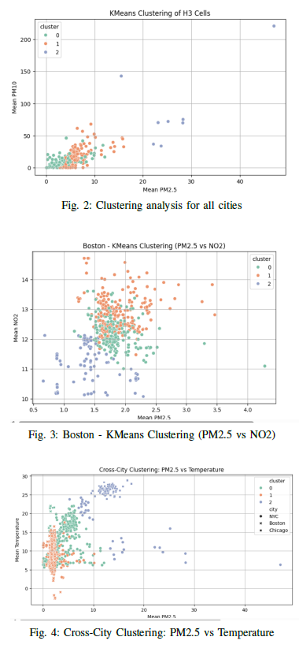
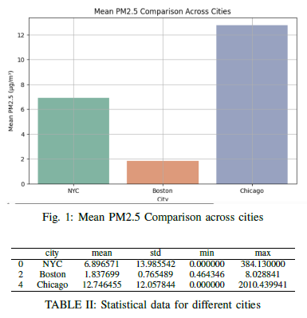
Results and Discussion
Chicago has highest PM2.5 levels, Boston lowest.
Pollution clusters associated with urban activity.
Weather significantly affects pollution, varies seasonally.
GIS indexing crucial for standardized comparison.
Notes:
Speaker Notes:
Our comprehensive analysis revealed significant variations in air quality among the three cities.
Chicago exhibited notably higher average PM2.5 concentrations compared to New York City and Boston,
Indicating specific urban dynamics influencing pollution levels.
Pollution clusters identified through spatial indexing predominantly align with transportation and industrial activities.
Meteorological conditions, particularly temperature and humidity, substantially influence PM2.5 concentrations,
highlighting the importance of seasonal strategies for air quality management.
The utilization of GIS-based H3 indexing was critical for enabling fair and standardized spatial comparisons across cities,
despite their intrinsic structural differences.

Slide 28
08
Policy Recommendations

Slide 29

Policy Recommendations
City-specific regulations needed.
Target traffic emissions in pollution hotspots.
Incorporate weather predictions in air quality alerts.
Notes:
Speaker Notes:
Given our findings, we propose several targeted policy recommendations.
First, regulations must be city-specific, reflecting unique local pollution patterns.
Second, urban planners should focus on reducing vehicle emissions in identified high-pollution zones
through improved traffic management strategies.
Third, integrating weather forecasting into air quality prediction systems could significantly enhance the precision
Of public health warnings, ensuring timely and effective responses to potential air quality deteriorations.

Slide 30
09
Conclusion and Future Work

Slide 31
Conclusion and Future Work
Input Data Sources
Data Collection & Preprocessing
Spatial Aggregation (H3 Indexing)
Spatial Analysis & Clustering
Predictive Modeling
Substantial intercity differences observed.
City-specific strategies essential.
Future studies to include more cities and additional environmental factors.
Longitudinal tracking recommended.
Notes:
Input Data Sources
PM2.5, PM10, NO2
Temperature, Humidity
Sensor locations (coordinates)
⬇️ (arrow pointing downward)
Data Collection & Preprocessing
Time synchronization
Missing value handling
Outlier detection and removal
⬇️
Spatial Aggregation (H3 Indexing)
Hexagonal spatial indexing
Feature engineering
Standardization of data (Resolution 9)
⬇️
Spatial Analysis & Clustering
K-Means clustering
Identification of pollution zones
Cluster profiling (low, medium, high pollution)
⬇️
Predictive Modeling
Multivariate regression (PM2.5 predicted by weather factors)
Validation methods (Bootstrapping, RMSE)
⬇️
Interpretation of Results
Comparative analysis
Hotspot identification
Weather impact analysis
⬇️
Policy Recommendations
City-specific strategies
Traffic emission management
Integration with weather forecasts for air quality alerts
Speaker Notes:
In conclusion, our study underscores the critical importance of localized air quality management strategies, supported by
robust geospatial analytics and predictive modeling techniques.
Significant intercity differences necessitate tailored approaches rather than broad national policies.
Moving forward, expanding this analytical framework to additional cities and incorporating broader environmental factors
like urban mobility could further refine understanding and improve policy effectiveness.
Longitudinal studies to track changes over time are highly recommended,
providing deeper insights into the evolving nature of urban air pollution and supporting sustained improvements in
public health and environmental quality.

Slide 32
Thank you

